Slide 1
Psychometrics and the Importance of Psychological Measurement
Chapter 1

Slide 2
Introduction
Impact of psychological measurement
  Answering the difficult questions.
  Quality of psychological tests.
  Life or death consequences???
Notes:
Impact of psychological measurement:
Almost every member of the industrialized society is affected by psychological measurement in some way.
Psychological tests impact one’s career, education, family life, safety, health wealth, and even happiness.
Life or death consequences:
While it may appear a little far stretched to say that psychological measurement can have death or life consequences, it is in fact true.
For instance, the General Assembly in North Carolina prohibits a person with “significantly subaverage” intellectual to be sentenced to death.
Answering the difficult questions:
To determine what can be termed as “significantly subaverage,” we need psychological tests.
General Assembly of North Carolina states that a person with significantly subaverage intellectual functioning is indicated by a score of 70 or below.
In other words, a person accused of crime but with an IQ score of 70 or below cannot be sentenced to death.
Quality of psychological tests:
Psychological tests have significant impact on one’s life and society.
Therefore, these tests must be of the highest quality and must be performed using the strongest possible tools and procedures.

Slide 3
Why Psychological Testing Matters to You
Potential real-life impact:
  Careers in behavioral science.
  Patients, educational testing of children, etc.
What happens when measures are inaccurate or taken incorrectly?
Notes:
Potential real-life impact: The basic principles of psychological measurement are important because any individual (practitioner of behavioral science, a behavioral researcher, or a sophisticated member of modern society) is very likely to be affected by it.
Careers in behavioral science:
Some careers (like the clinical psychologist, school psychologist, human resources director) that are involved in the practice or application of a behavioral science require the knowledge and understanding of psychological measurement.
Lack of a solid understanding of the basic principles of psychological measurement causes the test users to misinterpret or misuse the information obtained through the tests.
This in turn can lead to lawsuits for the test user.
Facing direct and indirect consequences:
People who do not fall into a career involving psychological measurement will still face its consequences in many direct and indirect ways.
For instance, parents must cope up with the educational testing of their children.
Job seekers may be hired based on scores in personality tests, and so on.
Importance of psychological measurement:
In any behavioral science, psychological measurement is at the heart of your research process.
When measurements are taken or when taken incorrectly, the test loses its scientific validity.
Evaluation of measurements yields accurate interpretation of your research findings.

Slide 4
Observable Behavior and Unobservable Psychological Attributes
Recall task and memory.
  More than a figment of imagination.
Psychological constructs: Attributes that cannot be directly observed.
Linking observable behavior with unobservable attributes.
Notes:
Recall task and working memory:
For the number recall scores to be valid, the recall task must be theoretically linked to working memory.
The test allows us to make an inference from an observable behavior to an unobservable psychological attribute, thus linking them theoretically.
More than a figment of imagination:
The third important feature about attempting to measure working memory is that the working memory is a more than a figment of imagination and a theoretical concept by itself.
Such theoretical concepts are called as hypothetical constructs or latent variables.
Hypothetical constructs:
It refers to attributes that cannot be directly observed but can be measured. Example: hunger, memory, and so on.
Operational definitions are used to measure hypothetical constructs.
Hypothetical constructs are often used to explain human behavior.
A classic example to show that measurement of certain observable events can be used to infer more about unobservable hypothetical events is the four forces that exist in the universe—strong force, gravity, electromagnetic force, and weak force.
Strong and weak empirical bases:
Sciences vary from one another based on the number as well as the nature of unobservable characteristics that matter to them.
Some sciences rely upon unobservable constructs with strong empirical bases (example: gravity) while the others have weak empirical bases (example: penis envy).

Slide 5
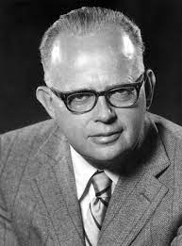
Psychological Tests: Definition and Types (1 of 7)
What Is a Psychological Test?
Compares behavior of two or more people.
Lee Cronbach: Three important components of psychological test.
  Behavioral Samples
  Systematic Collection of Data
  Detection of Differences
Notes:
Psychological test: According to Cronbach, it is “a systematic procedure for comparing the behavior of two or more people.”
Three important components of psychological test:
Cronbach’s definition includes three components—involvement of behavioral samples, systematic collection of behavioral samples, and detection of differences between people.
The definition includes several important features that add to its appeal.
Generality of the definition:
One of the appealing feature of the definition is its generality—that psychological tests can come in different forms.
For instance, the Beck Depression Inventory II is a traditional test to measure depression. However, there are certainly other tests by the definition of Cronbach to measure the same.

Slide 6
Psychological Tests: Definition and Types (2 of 7)
What Is a Psychological Test?
Generality of the definition!
  Tests can come in many forms!
  Example: How to measure depression?
Notes:
Psychological test: According to Cronbach, it is “a systematic procedure for comparing the behavior of two or more people.”
Three important components of psychological test:
Cronbach’s definition includes three components—involvement of behavioral samples, systematic collection of behavioral samples, and detection of differences between people.
The definition includes several important features that add to its appeal.
Generality of the definition:
One of the appealing feature of the definition is its generality—that psychological tests can come in different forms.
For instance, the Beck Depression Inventory II is a traditional test to measure depression. However, there are certainly other tests by the definition of Cronbach to measure the same.

Slide 7
Psychological Tests: Definition and Types (3 of 7)
Information produced by tests also varies!
  Can measure the extent to which someone possesses a psychological attribute
  Can group people into general categories based on their performance
Notes:
Information produced by tests:
Generality of the Cronbach definition extends to cover the type of information obtained from psychological tests.
Few tests produce numbers that reflect the extent to which an individual possesses a psychological attribute. Example: NAEP.
Other tests yield categorical data that groups people based on their responses. For example, House–Tree–Person Test.
General purpose of tests:
Finally, Cronbach definition covers the general purpose of psychological tests.
And this is to identify and, preferably, quantify interindividual or intraindividual differences.
These differences contribute to test score variability.

Slide 8
Psychological Tests: Definition and Types (4 of 7)
General purpose of tests?
  Identify individual differences
  Quantify these differences (measure them!)
  Presumably these differences in attributes == differences in test scores
Notes:
Information produced by tests:
Generality of the Cronbach definition extends to cover the type of information obtained from psychological tests.
Few tests produce numbers that reflect the extent to which an individual possesses a psychological attribute. Example: NAEP.
Other tests yield categorical data that groups people based on their responses. For example, House–Tree–Person Test.
General purpose of tests:
Finally, Cronbach definition covers the general purpose of psychological tests.
And this is to identify and, preferably, quantify interindividual or intraindividual differences.
These differences contribute to test score variability.

Slide 9
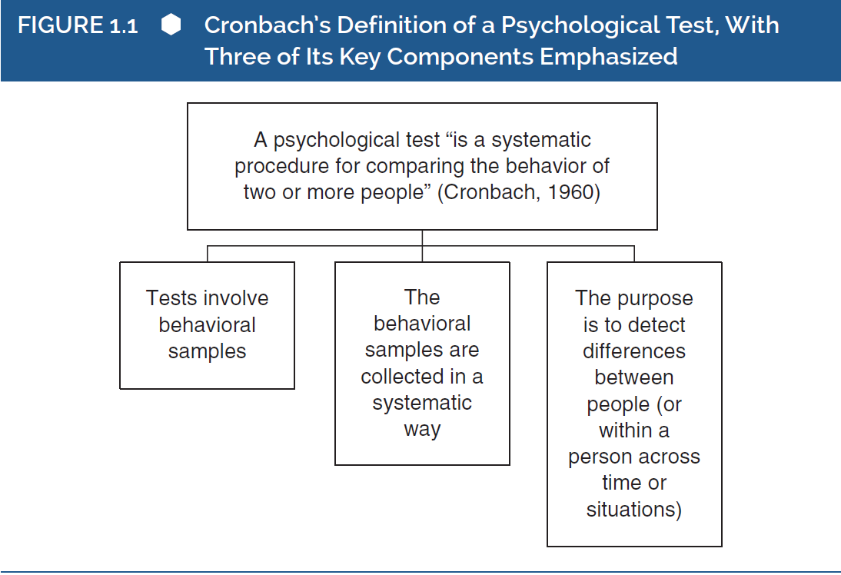
Psychological Tests: Definition and Types (5 of 7)
What Is a Psychological Test?
Notes:
Figure 1.1: Cronbach’s definition of a psychological test, with three of its key components emphasized.

Slide 10
Psychological Tests: Definition and Types (6 of 7)
Types of Tests
Speeded tests
  Timed! Based on number answered correctly in time limit
Power tests
  Not timed. Based on correct answers
Notes:
Speeded tests and power tests:
Speeded tests are time-limited tests in which the test takers are scored based on the number of questions answered within the stipulated time.
Power tests are not time limited and the individuals who take that are scored based on the number of correct answers and are expected to complete all questions.
Different methods are used to assess the quality of both test types.
Reflective or effect indicators:
When a hypothetical construct like intelligence determines the answers of an individual in a test, then the responses are referred to as reflective or effect indicators.
Reflective indicators are typical for most tests in psychology.
Formative or causal indicators:
When the indicators collectively define a construct, then they are referred to as formative or causal.
For instance, formative indicators like income, education, and occupation can collectively quantify a person’s socioeconomic status rather than being “caused” by his or her socioeconomic status.
Synonyms for the word—test:
Several words such as measure, scale, inventory and so on are used synonymously with test.
Choice of words depends on the author and context.

Slide 11
Psychological Tests: Definition and Types (7 of 7)
Types of Tests
Reflective or effect indicators.
  Hypothetical constructs!
  Most typical in psychology!
Formative or causal indicators.
  Indicators that collectively define a construct
    Example: Income, education, and occupation quantify SES stats
Synonyms for the word test:
  Measure, Scale, Inventory, etc.
Notes:
Speeded tests and power tests:
Speeded tests are time-limited tests in which the test takers are scored based on the number of questions answered within the stipulated time.
Power tests are not time limited and the individuals who take that are scored based on the number of correct answers and are expected to complete all questions.
Different methods are used to assess the quality of both test types.
Reflective or effect indicators:
When a hypothetical construct like intelligence determines the answers of an individual in a test, then the responses are referred to as reflective or effect indicators.
Reflective indicators are typical for most tests in psychology.
Formative or causal indicators:
When the indicators collectively define a construct, then they are referred to as formative or causal.
For instance, formative indicators like income, education, and occupation can collectively quantify a person’s socioeconomic status rather than being “caused” by his or her socioeconomic status.
Synonyms for the word—test:
Several words such as measure, scale, inventory and so on are used synonymously with test.
Choice of words depends on the author and context.

Slide 12
So what is Psychometrics?
Evaluating attributes of psychological tests.
  Data from tests
  Reliability of data from the test
  Validity of the data obtained from test
Testing == aspects of people
Psychometrics == aspects of test results
Notes:
Psychometrics:
It covers the procedures used for the evaluation of attributes of psychological tests.
The three main attributes of interest are: Type of data obtained from the tests, reliability of the data from the test, and issues around validity of data obtained from the psychological tests.
Psychological tests versus psychometrics:
Psychological tests are about attributes of people while psychometrics is about the attributes of the psychological tests.
Attributes of people are measured and can be unobservable too. The same can be said about attributes of psychological tests.

Slide 13
Challenges to Measurement in Psychology (1 of 3)
Accuracy of measurement.
Special challenges in behavioral sciences.
  Psychology vs. the physical sciences
Identification of important aspects from psychological attributes.
  What attributes are worth measuring?
  Boiling down human behavior/traits to a single number
Participant reactivity: change in outcome due to consciousness.
Notes:
Accuracy of measurement:
Any measurement can be affected by various types of errors including human error.
Therefore, no measurement is perfect and comes with its own set of challenges.
Special challenges in behavioral sciences:
Measurement challenges in behavioral sciences are greater than in physical sciences.
This leads to lowered confidence in presentation of observations.
Identification of important aspects from psychological attributes:
A key challenge of measurement in psychology is identifying the important ones from the many aspects of human psychological attributes in a single number.
In fact, no single number can completely represent an individual is a holistic manner.
However, specific psychological dimensions of an individual can be quantified and the challenge here would be to choose the specific dimensions that in fact reflect the complexity of those dimensions adequately.
Participant reactivity: When participants realize that they are being measured, they become more conscious of their answers and this in turn affects the outcomes of the test.

Slide 14
Challenges to Measurement in Psychology (2 of 3)
Different forms of participant reactivity.
  Social Desirability
  Demand characteristics
Bias and expectations of subjects.
Dependency on composite (combined) scores.
  More complicated than raw (individual) scores!
  Can be harder to evaluate without context
Score sensitivity in psychological measurement.
  Meaningful differences between scores
Notes:
Different forms of participant reactivity:
Participant reactivity come in different forms: demand characteristics, social desirability, and malingering.
All forms lead to the compromise of the validity and meaning of the measure.
Bias and expectations of subjects:
People involved in the measurement and collection of data, sometimes, tend to bring in their own biases and expectations.
Expectation and bias effects are difficult to detect and may be unconscious too.
Observer, or scorer bias, is more likely to occur in behavioral sciences than in physical sciences because, the latter relies more heavily on mechanical devices for collection of data.
Dependency on composite scores:
Measurement in social sciences, unlike in physical sciences, is more dependent on composite scores.
Composite scores have advantages but are more complicated to use and evaluate.
Score sensitivity in psychological measurement:
Sensitivity refers to the ability to discriminate between meaningful amounts of the dimension that is being measured.
For instance, the progress of an individual taking therapeutic sessions cannot be measured effectively by simply using a straightforward measure after each session.
An insensitive and crude scale of measurement in such cases must be replaced by a more precise and sensitive scale.
In other words, the scale must be able to distinguish the meaningful amounts of the dimension that is being measured (which is the progress of the patient in this case).

Slide 15
Challenges to Measurement in Psychology (3 of 3)
Lack of essential information.
Well-formed information.
  What is the reason for designing a specific test in a specific way?
Notes:
Lack of essential information:
The final challenge is psychometric measurement is the apparent lack of awareness of essential information.
Psychometric measurement involves the flow of information among people and yet such activities seem to happen with little or no regard for the psychometric quality of the tests.
Well-formed information:
While a class examination may motivate students to gather the relevant knowledge, the classroom instructors may not be able to clearly define the reason for conducting the exam.
In any case, psychometrically well-formed information is better than information that is not well formed and tests must have strong psychometric properties.
Handling of the challenges:
There lay important differences in measurement between physical and behavioral sciences.
These differences should be able to offer a better understanding of the collected data.
However, behavioral scientists have developed a good understanding of these challenges and have indeed generated effective methods to minimize the impact of the challenges in the measurement process.

Slide 16
The Importance of Individual Differences
Basis of psychometric information.
Assessment of psychometric properties.
  Test scores need to differ for assessment to occur!
  Differences in test scores mean difference in measured attribute.
Validation process: Association between score and degree of attribute
Evidence that the test is measuring what it is supposed to!
Notes:
Basis of psychometric information:
Individual differences in psychological measurement forms the crux of all methods used to evaluate tests.
The differences in behavior between two individuals are reflected through their test scores thus forming the basis of all psychometric information.
Assessment of psychometric properties:
Psychological measurement is about gathering behavioral samples using one of the many methods available.
The test scores thus obtained need to differ between people, in order to assess the psychometric properties of those scores.
Differences in test scores mean difference in measured attribute:
When a test is undertaken, the scores produced are different.
This implies that the differences can be directly related to the differences in the relevant underlying psychological attribute.
Validation process: The process through which the psychologist accumulates evidence that there is an association between individuals’ scores on a test and their actual degrees of an attribute is called the validation process.

Slide 17
But Psychometrics Goes Well Beyond “Differential” Psychology
(1 of 2)
Shift in research areas.
  Intelligence testing → Wider variety of characteristics
Differential psychology: study of individual differences.
Different views on psychometrics.
  Experimental psych vs differential psych
Notes:
Role of individual differences:
There is no doubt that individual differences play an important role in interpretation of psychometric information.
However, this does not imply that psychological measurement is only relevant to those who study a certain set of phenomena that are sometimes called “individual difference” variables.
Shift in research areas:
Psychometrics grew majorly on certain areas of research, such as intelligence testing.
While the early pioneers focused on general laws or principles of mental phenomena that apply to all people, some psychologists like Galton and Spearman turned toward the variability of human characteristics.
Differential psychology:
The study of individuals differences and it is generally believed to include intelligence, aptitude, and personality.
Differential psychology was the opposite of experimental psychology, in terms of its area of focus.
Different views on psychometrics:
Some people viewed psychometrics as an issue concerning people who study “individual differences.”
The others believed psychometrics is not a concern for those who take a more experimental approach to human behavior, however, this is incorrect.

Slide 18
But Psychometrics Goes Well Beyond “Differential” Psychology
(2 of 2)
Not just issues for differential psychology! All areas of psych rely on measurement!
All research has a degree of variability!
  Identification and quantification of the variability.
Notes:
Understanding of problems:
The issues of psychometrics are not related to differential psychology alone.
Irrespective of the area of research or practice, all psychologists must understand the problems of psychological measurement.
Identification and quantification of the variability:
All behavioral sciences and its applications depend on the ability to identify and quantify variability in human behavior.
Psychometrics is the study of procedures that are used to measure this variability.

